Slide 1





Style and Theme Ionic Application
Fauzi Sholichin
fauzisholih@gmail.com
+6289673732142
https://www.linkedin.com/in/fauzisho/

Slide 2
Introduction
Setting global Sass variables
Defining style configuration properties
Setting specific styles
The foundation to build your customized application.
How to use the built in CSS utilities to assist with many of he common layout needs

Slide 3
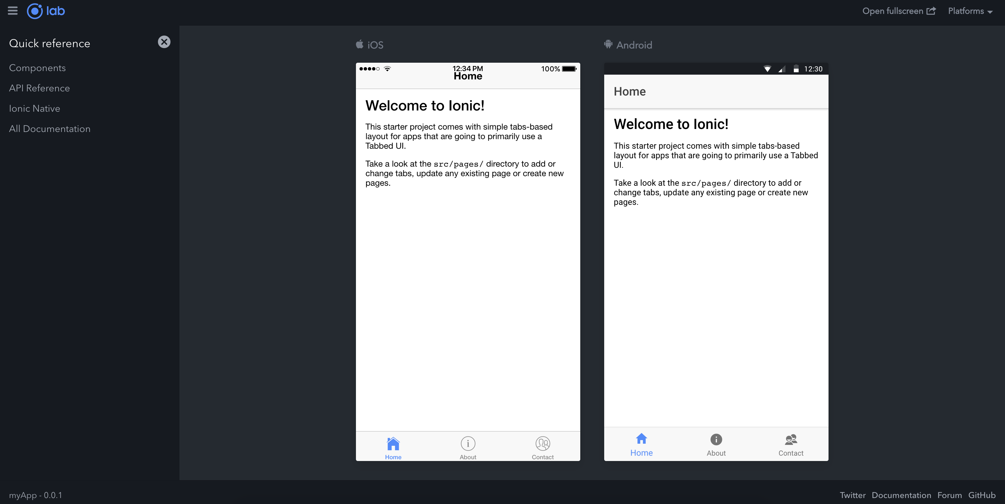
Introduction ionic lab

Slide 4
Setting App Theme Light/Dark
To change it to dark, we'll visit /src/theme/variables.scss and at the bottom, we simply change:
// From
@import "ionic.theme.default";
// To
@import "ionic.theme.dark";

Slide 5
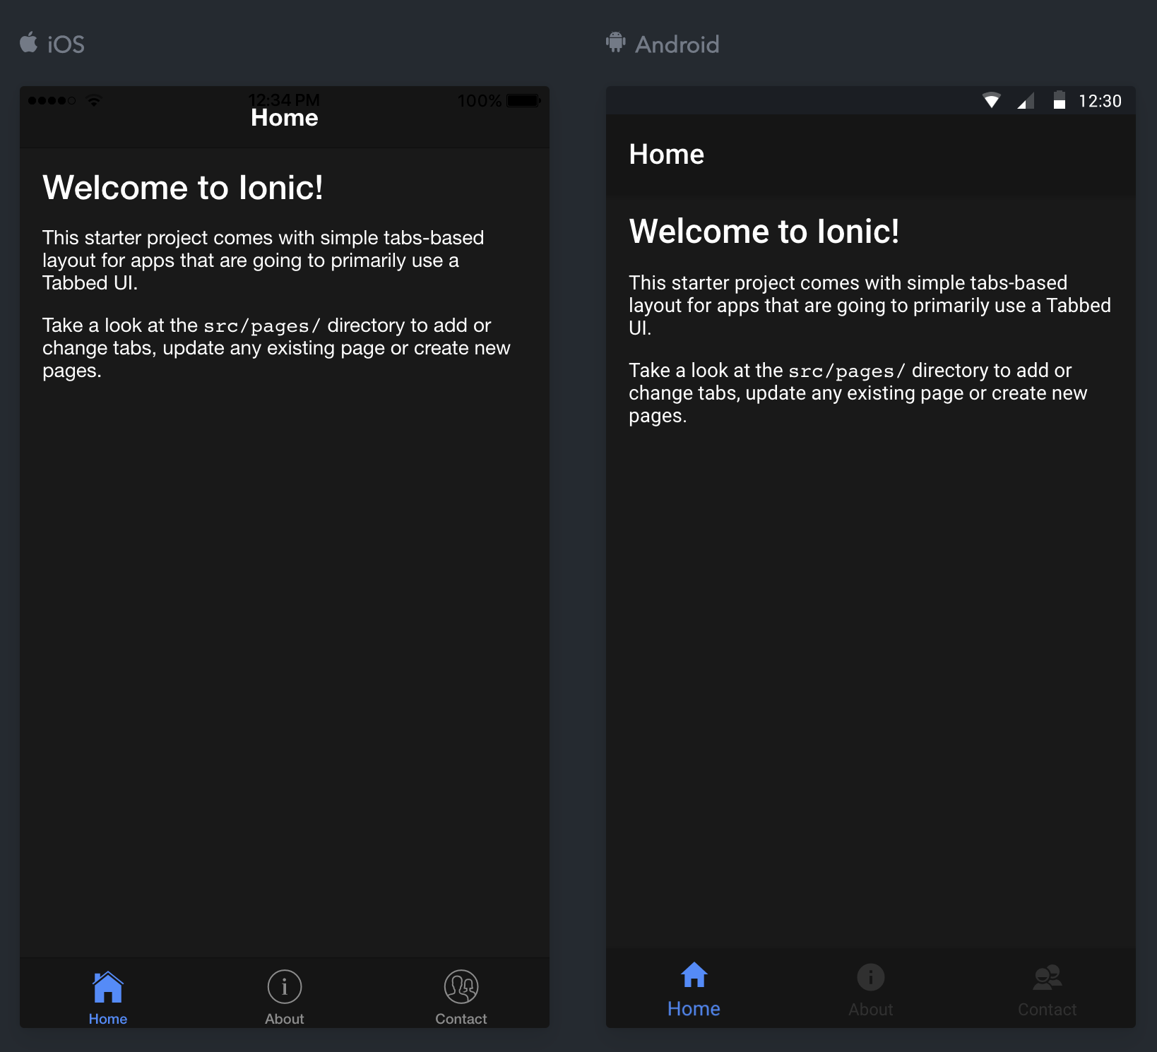
Theme Dark

Slide 6
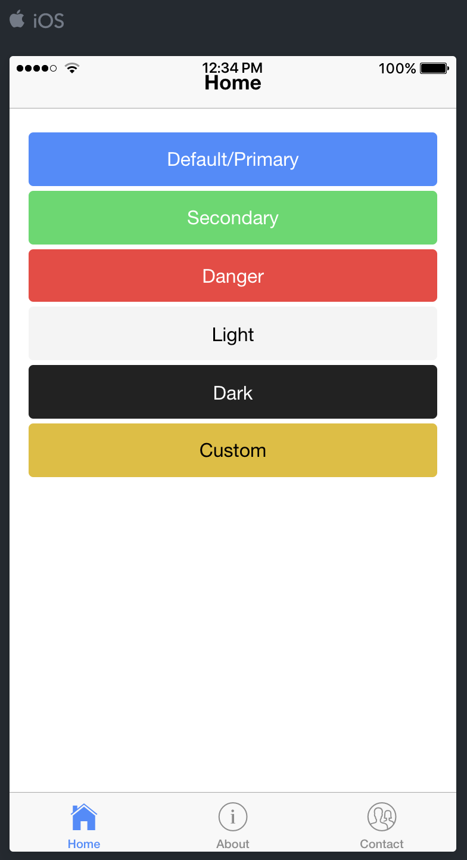
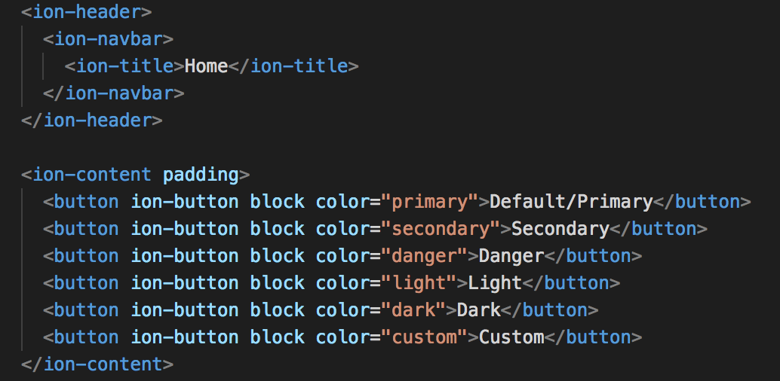
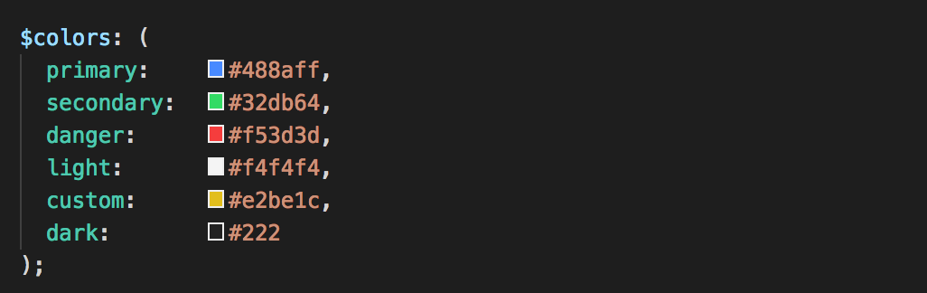
Customize Ionic Default Theme Colors
home.html
variables.scss

Slide 7



Customize Ionic Default Theme Colors
variables.scss
Notes:
If we want more control, we can combine the colors further
by setting the base color and its contrast color.
We can see the result of the contrast color in how the text is colored in each button.

